Slide 1
BRIGHT COFFEE SHOP
Executive Sales Performance Review
Key findings and recommended actions | January–June 2023
TOTAL REVENUE
QUANTITY SOLD
TRANSACTIONS
AVG. REVENUE / TRANSACTION
698,812.33
214,470
149,116
4.69
Purpose: turn historical sales patterns into practical decisions on stock, staffing and promotions.

Slide 2
Sales Analysis
& Performance Dashboard
A data-driven review of sales, products, stores, and customer purchasing patterns

Slide 3
1. Project Overview
Analyse coffee shop sales data to understand business performance.
Measure revenue, quantity sold, and transaction activity.
Compare performance by month, product category, product type, store, day, and time.
Build interactive dashboards to communicate findings clearly.
MAIN QUESTION
What drives sales performance, and where can the business improve?
2

Slide 4
2. Project Workflow & Tools
01
Plan
02
Prepare
03
Analyse
Miro architecture
Review and clean data
SQL in Databricks
04
Summarise
05
Visualise
06
Present
Excel pivot tables & charts
Power BI , Looker Studio,databricks,lovable,excel
Insights and recommendations
3

Slide 5
3. Data & Key Measures
TRANSACTIONS
PRODUCTS
OPERATIONS
MEASURES
transaction_id
transaction_date
transaction_qty
product_category
product_type
product_detail
store_location
Day_name
time_classification
day_classification
revenue
number_of_sales
unique_products
number_of_stores
Revenue was analysed alongside units sold and distinct transactions to avoid relying on a single performance measure.
4

Slide 6
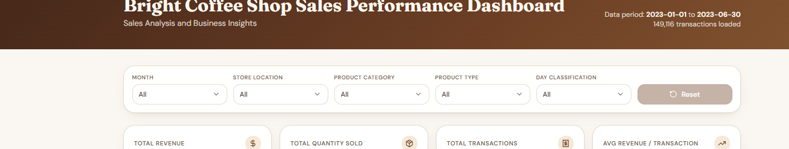
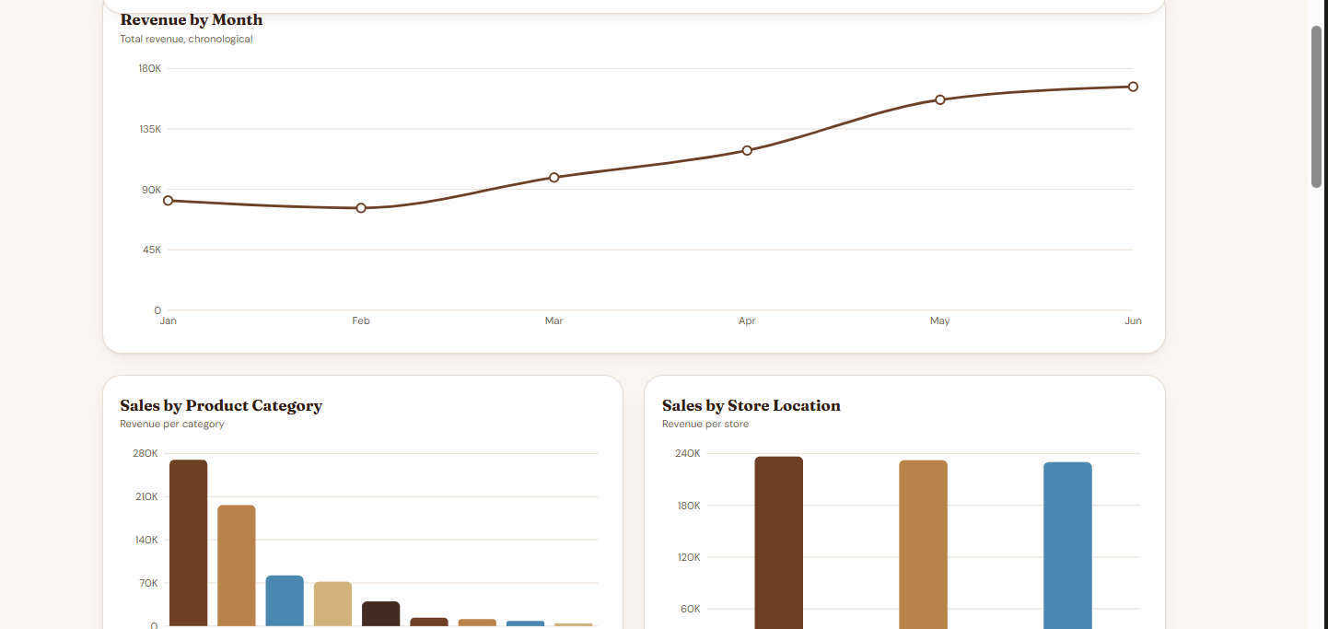
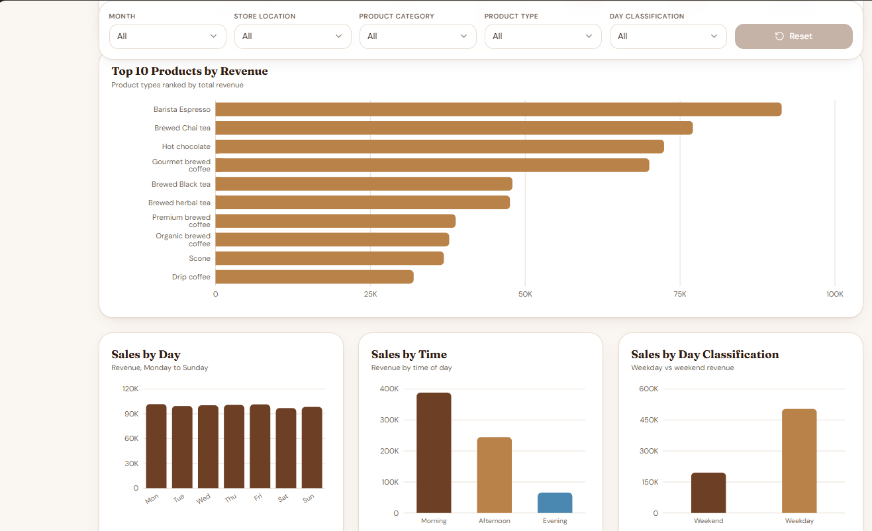
Sales Performance

Slide 7
Sales Performance
Revenue by Month
Sales by Product Category
Track revenue trends across the reporting period.
Compare the contribution of each category.
Sales by Store Location
Top 10 Products by Revenue
Identify differences between store locations.
Highlight the products contributing most revenue.
Sales by Day & Time
Quantity Sold by Product
Compare revenue across weekdays and time periods.
Identify high-volume product types.
Sales by Day Classification
Compare weekday and weekend performance.
6

Slide 8
6. Interactive Dashboard Features
Date range — view a selected reporting period 2023-01-01 to 2023-06-30.
Store location — focus on an individual location.
Product category — compare broad product groups.
Product type — explore individual product types.
Day classification — compare weekdays and weekends.
WHY FILTERS MATTER
This helps us investigate questions such as which store or product group performed best during a chosen period.
7

Slide 9
What the Sales Data Tells Us
Monthly trend
June had the highest revenue (166,486), while February had the lowest (76,145).
Product performance
Coffee was the top category (269,952; 38.6% of revenue). Barista Espresso was the top product by revenue.
Store comparison
Hell's Kitchen had the highest revenue (236,511; 33.8%); Lower Manhattan had the lowest.
Time and day
Monday was the highest-revenue day (101,677); Morning was the strongest time period (388,289; 55.6% of revenue).
Units vs revenue
Not exactly. Brewed Chai Tea and Gourmet brewed coffee lead in quantity, while Barista Espresso leads in revenue.
8

Slide 10
8. Recommendations
Stock planning
Use quantity sold by product to support replenishment decisions.
Product promotion
Promote products with lower sales after checking margin and seasonality.
Staffing
Use day and time patterns to plan staffing for busy periods.
Store operations
Compare store results and investigate differences before taking action.
Ongoing monitoring
Refresh the dashboard regularly and track KPIs over time.
9

Slide 11
Conclusion
The Bright Coffee Shop Sales Analysis examined sales data from January to June 2023 using dashboards and visualisations to understand revenue, product performance, store performance, and customer purchasing patterns.
The results showed that June recorded the highest monthly revenue, Coffee was the leading product category, Hell's Kitchen was the highest-revenue store, and morning was the strongest sales period. The quantity and revenue charts also showed that the most frequently purchased products do not always rank first by revenue.
Based on these findings, Bright Coffee Shop should maintain sufficient stock of popular products, plan staff and preparation around peak morning demand, review practices at the strongest-performing store, and use targeted promotions to encourage sales during quieter periods. These actions can support better inventory planning and more informed business decisions.
Overall, the analysis turns historical sales data into practical actions for improving operations and supporting future growth.

Slide 12
9. Dashboard Results — KPIs & Monthly Revenue
INSIGHTS
• Total revenue is 698,812.33.
• The dashboard reports 214,470 units sold and 149,116 transactions.
• Average revenue per transaction is approximately 4.69.
• Monthly revenue rises overall from February through June, with a small dip in February. June is the highest month shown.
11

Slide 13
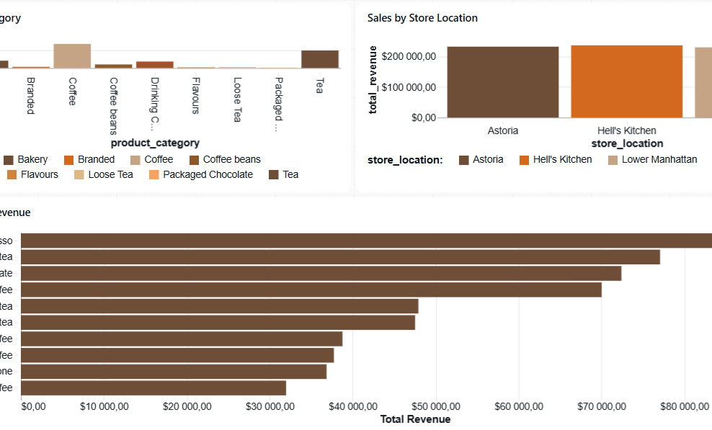
10. Product & Store Performance
INSIGHTS
• Coffee is the largest revenue category in the category chart; Tea is also a major contributor.
• The three store locations have broadly similar total revenue, with Hell’s Kitchen slightly highest in the screenshot.
• Barista Espresso is the top product by revenue, followed by Brewed Chai Tea and Hot Chocolate.
• Use these results to guide product promotion and stock planning.
12

Slide 14
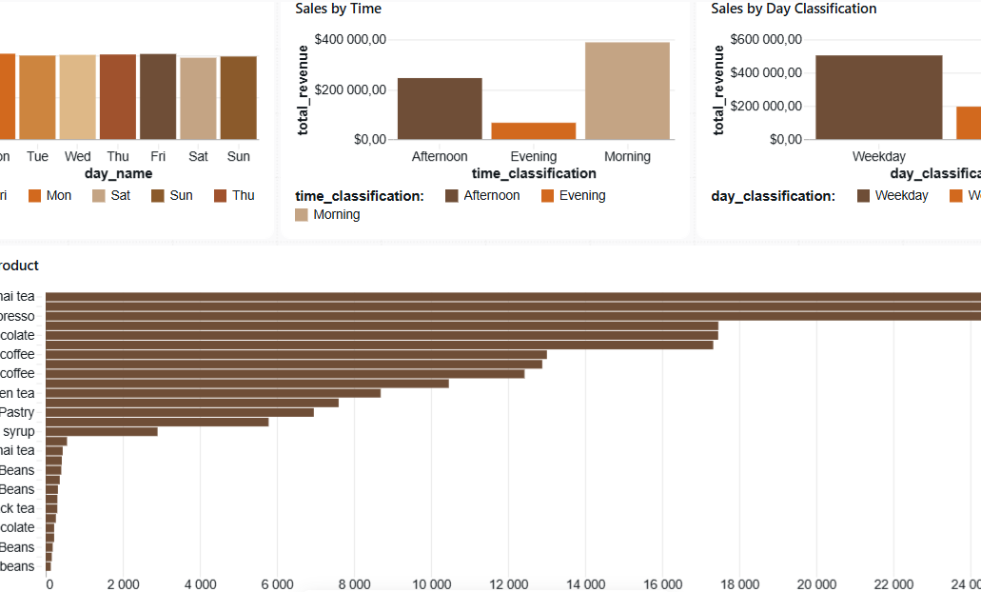
11. Sales Patterns — Day, Time & Quantity
INSIGHTS
• Morning has the highest revenue among the displayed time periods; Evening is the lowest.
• Weekday revenue is substantially higher than weekend revenue in the current chart.
• Daily revenue appears fairly even across the seven days, with Friday among the highest days shown.
• Brewed Chai Tea and Barista Espresso lead the quantity chart, indicating strong unit demand.
13

Slide 15
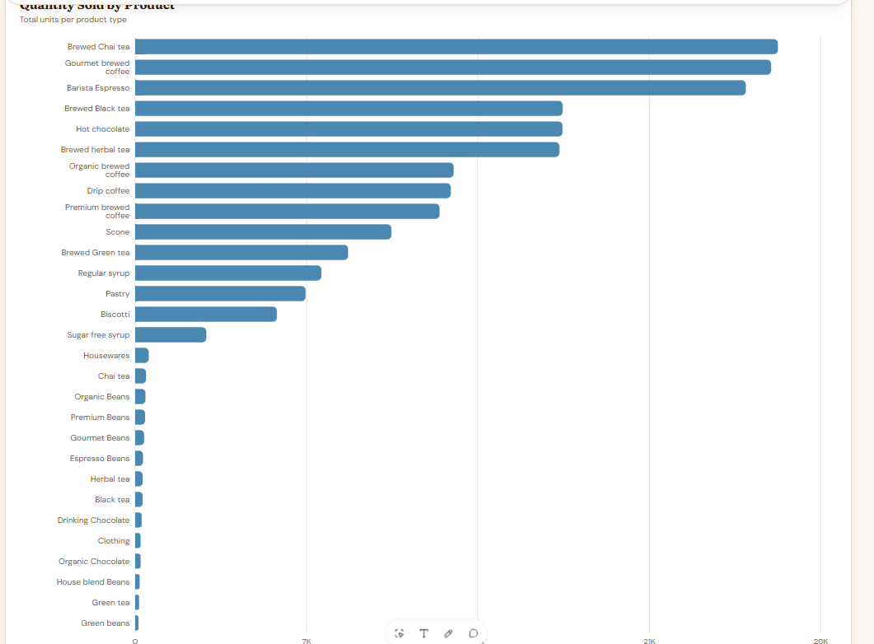
Business Insights
Inventory
Prioritise stock availability for Barista Espresso and Brewed Chai Tea, which lead the displayed revenue/quantity charts.
Promotions
Review lower-revenue categories and products for targeted promotions, while checking profit margins before discounting.
Staffing
Use the strong morning revenue pattern to review staffing and preparation levels during morning hours.
Store review
Compare store operations and investigate why Hell’s Kitchen appears slightly ahead in the current view.
Monitoring
Use the date and category filters to compare periods consistently; validate totals after changing filters.
14

Slide 16
Business Insights
Monthly trend
Best product category
Top store location
INSIGHT
INSIGHT
INSIGHT
June was the highest-revenue month (166,486); February was the lowest (76,145), a gap of about 118.6%.
Coffee leads with 269,952, representing 38.6% of total revenue.
Hell's Kitchen generated the most revenue (236,511; 33.8%); Lower Manhattan was the lowest at approximately 32.9%.
IMPLICATION
IMPLICATION
IMPLICATION
Revenue changes notably month to month, affecting inventory and staffing needs.
The business depends heavily on Coffee; supply or quality problems could affect revenue most.
Store performance is fairly balanced across locations.
RECOMMENDATION
RECOMMENDATION
RECOMMENDATION
Plan inventory and rosters around peak months such as June, and run promotions in slower months such as February.
Protect Coffee supply and use it as the anchor for bundles with smaller categories.
Study what works at Hell's Kitchen (menu, hours, staffing) and test suitable improvements at Lower Manhattan.
Top revenue products
Strongest day
Peak time of day
INSIGHT
INSIGHT
INSIGHT
Barista Espresso, Brewed Chai Tea, and Hot Chocolate together contribute 34.5% of revenue.
Monday is the highest-revenue day (101,677); Saturday is the weakest.
Morning is the strongest period (388,289; 55.6% of revenue).
IMPLICATION
IMPLICATION
IMPLICATION
A small group of products drives a sizeable share of sales.
Demand shifts across the week.
Most customers buy in the morning, so service speed is especially important then.
RECOMMENDATION
RECOMMENDATION
RECOMMENDATION
15

Slide 17
14. Quantity Sold — Product Demand
What the chart shows
Brewed Chai Tea, Gourmet brewed coffee, and Barista Espresso are the highest-volume products in the displayed chart. Several products appear to have very low unit counts compared with these leaders.
Business implication
Stocking decisions should consider unit demand as well as revenue. A product can sell many units without generating the highest revenue, so both measures are useful.
Recommendation
Monitor stock levels for the highest-volume products, review slow-moving items, and compare sales volume with profit margin before changing prices or promotions.
16

Slide 18
Decisions for Management
Recommended next steps based on the January–June 2023 analysis
01
Protect availability of top sellers
Monitor stock for Coffee-category items and leading products, especially Barista Espresso and Brewed Chai Tea.
02
Plan staffing around demand
Use the strong morning sales period to guide staff rosters, preparation and service coverage.
03
Test targeted promotions
Run measured promotions during slower months or quieter periods; compare revenue before and after each campaign.
04
Review store-level practices
Study Hell's Kitchen's performance and test transferable practices at Lower Manhattan.
Management follow-up: agree on owners, targets and a monthly review cadence for these actions.

Slide 19
Conclusion
The January–June 2023 data shows that Bright Coffee Shop generated 698,812.33 in revenue across 149,116 transactions.
Revenue was strongest in June, Coffee was the leading category, Hell's Kitchen was the top-revenue store, and mornings were the busiest sales period.
The opportunity is to protect popular products, align staffing with peak demand, and test targeted promotions—then track results monthly to confirm impact.
Thank you | Questions and discussion

